Slide 1
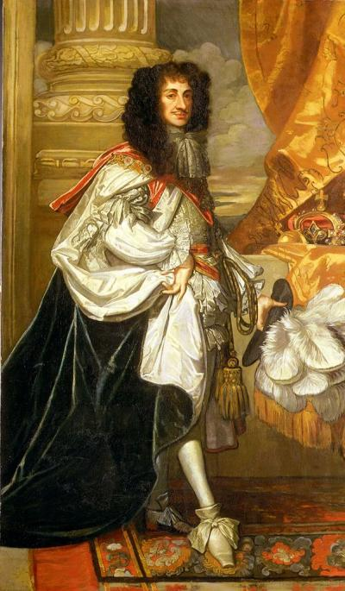
Charles II and the Restoration
"a prince of many virtues and many great imperfections, debonair, easy of access, not bloody or cruel"

Slide 2
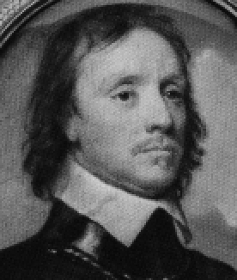
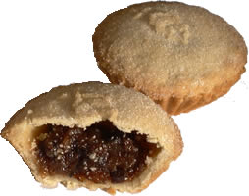
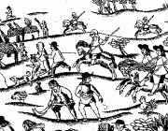
Think back…
Why did the English want a king back on the throne in 1660? A few clues below…

Slide 3
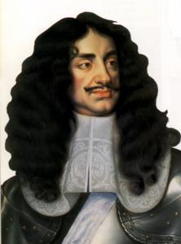
Charles II
What do we know so far?

Slide 5
Charles II Profile
Name:
Parents:
Date of Birth:
Years of reign:
Wife:
Appearance:
Religious beliefs:
Personality:
Nickname:
Children:

Slide 6
What did he do first?
Charles II had been very fond of his father, Charles I. What do you think he would have been most keen to do when he became king in 1660?

Slide 7
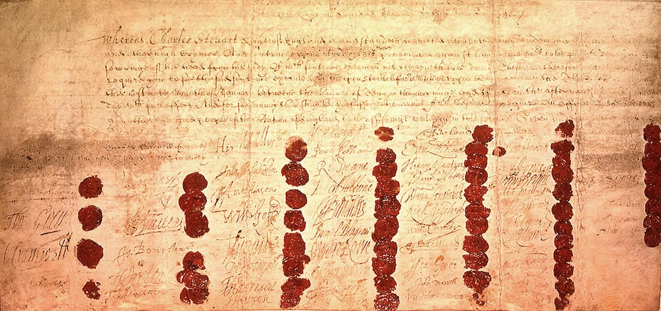
The Act of Indemnity and Oblivion
Charles did not want to create enemies for himself at the start of his reign. He forgave most of those who had opposed his father and decided to punish only those directly responsible for Charles I’s death.
These people were known as the regicides. These were the 59 Commissioners (judges) who sat in judgement at the trial of King Charles I and signed his death warrant in 1649, along with other officials who participated in his trial or execution.

Slide 8
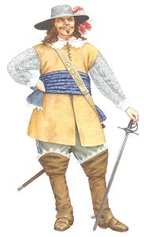
The Regicides are punished
Although some were pardoned and a few escaped to Europe or America, 13 were executed and 19 were imprisoned for the rest of their lives.
Three men who had already died by 1660, including John Bradshaw and Oliver Cromwell, were ‘posthumously executed’, meaning that their bodies were dug up, and then hanged, drawn and quartered.
Cromwell’s head was displayed on a pole outside Westminster Abbey until 1685.
At last Oliver Cromwell is getting what he deserves.

Slide 9
What did he do next?
Charles II was keen to put the bad days of the Republic behind him. What laws do you think he would have wanted to overturn?

Slide 10
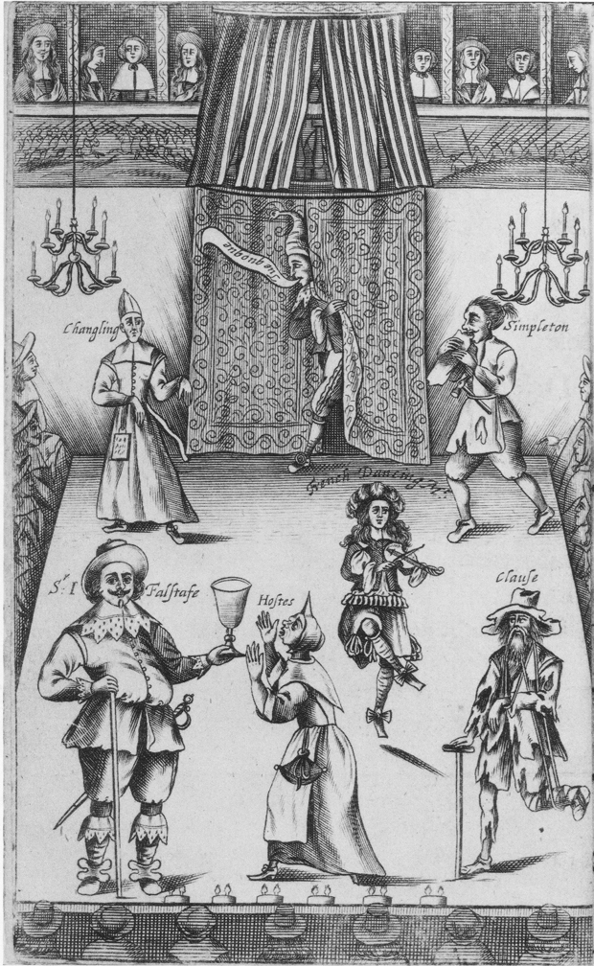
All of them!
Charles declared all the laws that had been passed between 1649 and 1660 to be illegal.
This meant that the old, familiar Church of England was brought back, and all the laws that had tried to make people live a Puritan lifestyle were abolished.
Theatres and alehouses reopened. There was a wave of new plays, music and poetry written.

Slide 11
But not everything went well…
But Charles’ reign was not without its problems. He argued with Parliament over money and religion (but without going as far as his father had).
His reign also saw the Great Plague hit England in 1665 – as many as 100,000 people died in London alone.
The plague was followed by the Great Fire of London in 1666, which destroyed the heart of the city.
He had no legitimate heir. Charles had 14 children, but none of them were with his wife…
If all this wasn’t enough, Charles got involved in a war against the Dutch, and then to make things worse, he began secret negotiations with the French king, who was a Catholic. People had always had their suspicions about Charles, and then…

Slide 12
He became a Catholic
…in 1685, Charles suffered a stroke. On his deathbed he sent away all the Anglican priests around him and sent for a Catholic priest. Charles said that he was truly a Catholic. No one could object to this or stop him now.
And who was next in line to become king…?

Slide 13
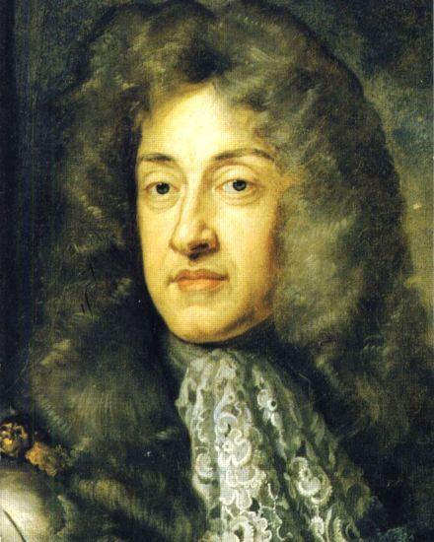
James II
What made things even worse (as far as Parliament and many English people saw it) was that Charles’ brother James, would now become king – and he was definitely a Catholic…
Can you foresee any problems?

