Slide 1
Torture instruments.
The Head Crusher...

Slide 2
Why it was used...
It was used to make people confess to a crime that they may not have even committed.
It was a good tool as if the poor person being tortured does not confess then their head will be crushed plus even if they do confess they may be left with permanent damage.

Slide 3
What happened...
Firstly the scalp of the person of the person was placed in a cap and the chin on a metal bar.
Then the lever on the top was twisted slowly pushing the cap down and compressing the head against the bar.

Slide 4
What else happens [Not for the feint hearted]
Firstly the teeth and jaw get pushed into the head shattering all of their teeth and crushing their jaw.
They would suffer an agonizing death but not before their eyes popped out from their sockets.
If the torturer stopped midway then the victim may have a deformed face and/or have irreparable damage done to the eyes jaw or teeth.

Slide 5
Attatchments
One attachment for the head crusher is called an eye catcher.
They would a trough on the end to catch the persons eyes as they pop out.
They did this to stop their eyes rolling all over the floor and making a mess.

Slide 6
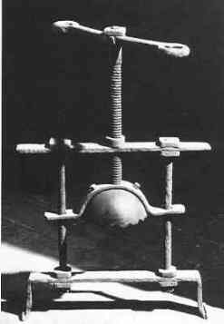
A picture of the headcrusher

Slide 7
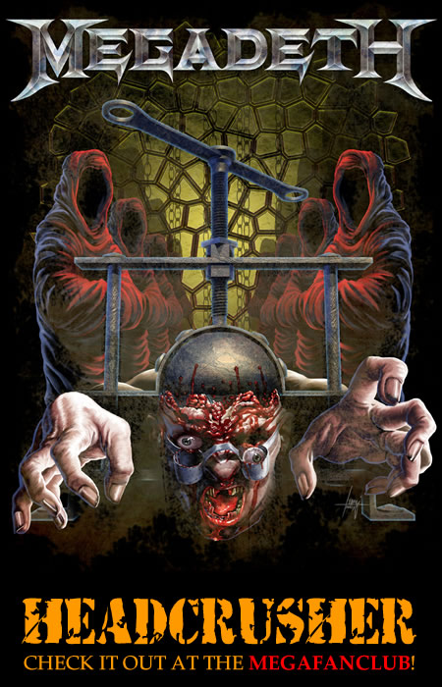

How popular?
The head crusher is so popular even now the totally infamous band megadeth sang a whole song about this very gruesome and horrific device.

Slide 8
Who was it used on?
It was used pretty much purely used on people such as Thief's.
They are not used on other types of crime committers.
The worse the crime they have committed, the more slow and painful the torturer will make their death.

Slide 9
THANKS FOR WATCHING!!!!!!

