Slide 1
Stuart torture devices
By Findley Smylie

Slide 2
THE RACK!!!!!!!!!!!!!
On the rack, a victims legs and arms were tied to bars at either end of the device, rollers were then used to stretch the body. The tension was maintained and gradually increased by use of a ratchet.
This caused terrible pain for the victim as well as increasing physical damage as the torture continued. Tendons were ripped, joints separated and bones fractured. The sounds of muscles and tendons tearing and snapping provided audible signs of the damage being done. A victim of the rack was often left with permanent physical disability. For example, because of injuries suffered after being racked three times the Jesuit priest Edmund Campion was unable to raise his hand to swear at his trial.

Slide 3
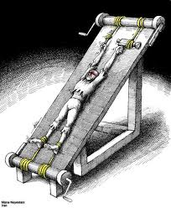

Slide 4
The manecles
Eventually, public disgust led to the Rack’s use being restricted. Richard Topcliffe, a notorious torturer, claimed to have invented the use of ‘gauntlets’ or manacles as a torture instrument. This was considered to be a lesser form of torture, however, this distinction may well have been lost upon people who experienced it. John Gerard, another Jesuit Priest described being hung by his wrists from a post in a torture chamber in the Tower of Londonsuch a gripping pain came over me

Slide 5
continued
It was worst in my chest and belly, my hands and arms. All the blood in my body seemed to rush up into my arms and hands and I thought that blood was oozing out from the ends of my fingers and the pores of my skin. But it was only a sensation caused by my flesh swelling above the irons holding them. The pain was so intense that I thought I could not possibly endure it.’
Gerard remained hanging for several hours and was only taken down after fainting. As soon as he revived he was put back into the manacles and suspended again. This continued until after 5′oclock when he was eventually returned to his cell. Incredibly, Gerard never broke and maintained his refusal to answer the questions put to him.

Slide 6
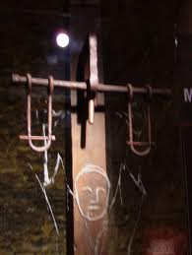

Slide 7

Sponsored by Ryan warner

