Slide 1
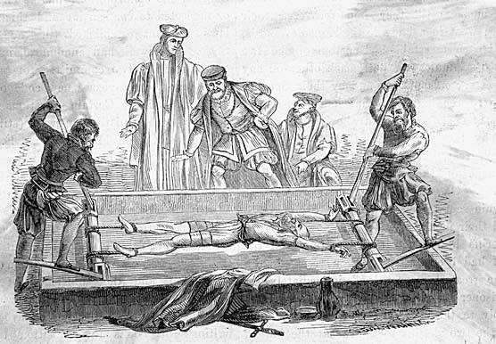
The Rack!...
Sam Nickels
J/KSB - 8P

Slide 2
What Is It
The rack is a torture device consisting of a rectangular, usually wooden frame, slightly raised from the ground, with a roller at one or both ends. The victim's ankles are fastened to one roller and the wrists are chained to the other. The torturer turns the rollers, stretching the victim’s limbs and often breaking cartilage, ligaments, and/or bones.

Slide 3
Used between
First used: Spain, Saint Vincent of Saragossa – 304 AD
Last Used: Texas, USA ‘unstated’ – 12/03/2011 (these days, torture is very rare and this is the first time this as happened since the 1700’s)
Arrived in Britain: 1447

Slide 4
Famous victims of the rack
Many knights from the Knights Templar
Guido ‘Guy’ Fawkes

Slide 5
DID ANYONE EVER ALTER IT
The French added spiked rollers that were inserted under the spine of the victim, causing even more pain.
The Russians suspended the victims and whipped them and sometimes burned them with hot torches.

Slide 6


